Slide 1
Reactor
Foundational framework for Reactive, Fast Data applications on the JVM
Jon Brisbin
Reactor Project Lead

Slide 2
What is Reactor?
Reactor is a foundational library.
Plays in grey area between user-level and lower-level abstractions.
Components and application cores can be built on Reactor.
Drivers, servers, data integration libraries, domain integration libraries, evented architectures.

Slide 3
What is Reactor?
Reactor is a distillation of other libraries and best-practices.
Elements of other patterns and libraries surface throughout Reactor's abstractions.

Slide 4
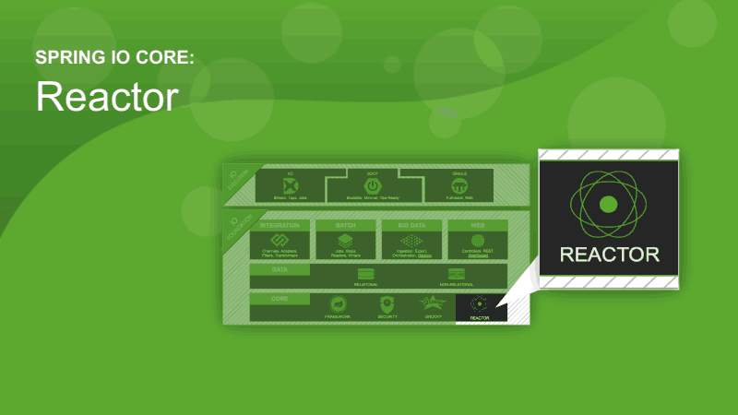
What is Reactor?

Slide 5
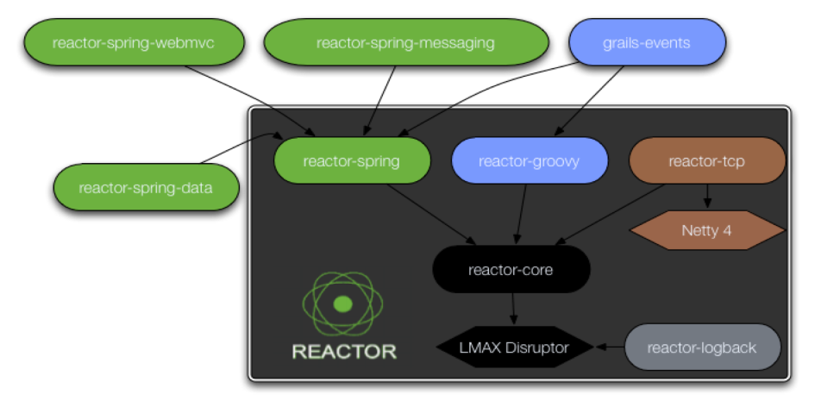
What is Reactor?

Slide 6
What is Reactive?
“Reactive programming can be seen as a natural extension of higher-order functional programming to concurrent systems that deal with distributed state by coordinating and orchestrating asynchronous data streams exchanged by actors.”
https://www.coursera.org/course/reactive

Slide 7
What is Reactive?
Reactive Extensions in .NET
http://rx.codeplex.com/
Netflix RxJava
https://github.com/Netflix/RxJava
Observer pattern
http://en.wikipedia.org/wiki/Observer_pattern

Slide 8
How is Reactor reactive?
Reactor applications route events based on a Selector
Like a routing topic, but can be any object
$(“string”)
$(anonymousObject)
RegexSelector: R(“topic.(.+)”)
UriTemplateSelector: U(“/{path}/{segment}**”)
ClassSelector: T(Throwable.class)
JsonPathSelector: J(“$.”)

Slide 9
What does the code look like?

Slide 10
What does the code look like?

Slide 11
What does the code look like?

Slide 12
What is Fast Data (and #uberfastdata)?
High throughput: millions per second.
Selector-based dispatch: 10-15MM/sec
RingBuffer Processor: 100MM/sec
Low latency: microseconds per request.
DO. NOT. BLOCK!
High volume: billions per minute/hour/day.
High sustained throughput

Slide 13
Reactor - Dispatchers
Dispatchers manage task execution
ThreadPoolExecutorDispatcher
Backed by standard ThreadPoolExecutor
BlockingQueueDispatcher
Event Loop style
RingBufferDispatcher
LMAX Disruptor RingBuffer
SynchronousDispatcher

Slide 14
Reactor - Selectors
Can be created from any object using $(obj).
Or use the long form: Selectors.object(obj)
Can extract data from the matched key.
U(“/{path}/{segment}”) results in headers “path” and “segment”
Predicate<T> Selectors can match on domain-specific criteria
Header values
Object values
Time/Date
Moon Phase
Position of the ISS

Slide 15
Reactor - Streams
Streams allow for composition of functions on data
Callback++
Netflix RxJava Observable, JDK 8 Stream
stream.map(String::toUpperCase)
.filter(new Predicate<String>() {
public boolean test(String s) { … }
})
.consume(s → log.info(“consumed string {}”, s));

Slide 16
Reactor - Promises
Promise<String> p;
String s = p
.onSuccess(s → log.info(“consumed string {}”, s))
.onFailure(t → log.error(t.getMessage(), t))
.onComplete(t → log.info(“complete”))
.await(5, SECONDS);
p.map(String::toUpperCase).consume(
s → log.info(“UC: {}”, s)
);

Slide 17
Reactor - Processor
Processor<Buffer> proc;
Operation<Buffer> op = proc.prepare();
op.get().append(data).flip();
op.commit();
proc.batch(512, buff → buff.append(data).flip());

Slide 18
Reactor - Spring
@Configuration
@EnableReactor
public class ReactorConfiguration {
@Bean
public Reactor input(Environment env) {
return Reactors.reactor(env);
}
@Bean
public Reactor output(Environment env) {
return Reactors.reactor(env);
}

Slide 19
Reactor - Spring
@Component
public class SimpleHandler {
@Autowired
private Reactor reactor;
@Selector(“test.topic”)
public void onTestTopic(String s) {
// Handle data
}
}

Slide 20
Reactor - Demo

Slide 21
Reactor – Random Awesomeness
TCP Client/Server, with a Netty 4 implementation
Buffer tools
Sequencer support, for event ordering
Work Queue support, with OOTB Java Chronicle implementation
Logback Appender
Dynamic Interface-based event proxies

Slide 22

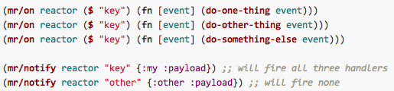
Reactor – 3rd Party Support
Meltdown: A Clojure binding by @michaelklishin & @ifesdjeen
https://github.com/clojurewerkz/meltdown
Couchbase: v2 Java SDK platform

Slide 23
Reactor – Spring Framework 4.0
STOMP
Reactor TCP handles STOMP broker relay
ReactorSubscribableChannel
SubscribableChannel implementation

Slide 24
Reactor – Spring Integration
ReactorProcessorMessageDispatcher
Pluggable into any MessageChannel that takes a MessageDispatcher
XML Namespace support
<int-reactor:syslog-inbound-channel-adapter id="syslog" port="${port:5140}" channel="output" auto-startup="false"/>
More Integration planned in near future

Slide 25
Reactor – Spring XD
TCP + Netty: Supports all standard Netty Codecs
HTTP, FTP, SMTP, WebSocket, protobuf, etc…
Syslog: Standard syslog ingest using Reactor TCP
reactor-syslog: ~700k/sec
syslog-tcp: ~30k/sec
MessageBus: Using Selectors like topics and queues
Based on RedisMessageBus

